Slide 1

Causal Modelling with Variational Autoencoder

Slide 2
Objective
Identifying causal relationship and apply causal operations on the dSprite dataset images using image data and labels
Perform Counterfactual Queries on the dataset.

Slide 3






Dataset overview
dSprites is a dataset of sprites, which are 2D shapes procedurally generated from 6 ground truth independent factors.
All possible combinations of these variables are present exactly once, generating N = 737280 total images.
The independent factors:
Color: 1 value (white)
Shape: 3 values {square, ellipse, heart}
Scale: 6 values linearly spaced in (0.5, 1)
Orientation: 40 values in (0, 2 π )
Position X: 32 values in (0, 1)
Position Y: 32 values in (0, 1)

Slide 4
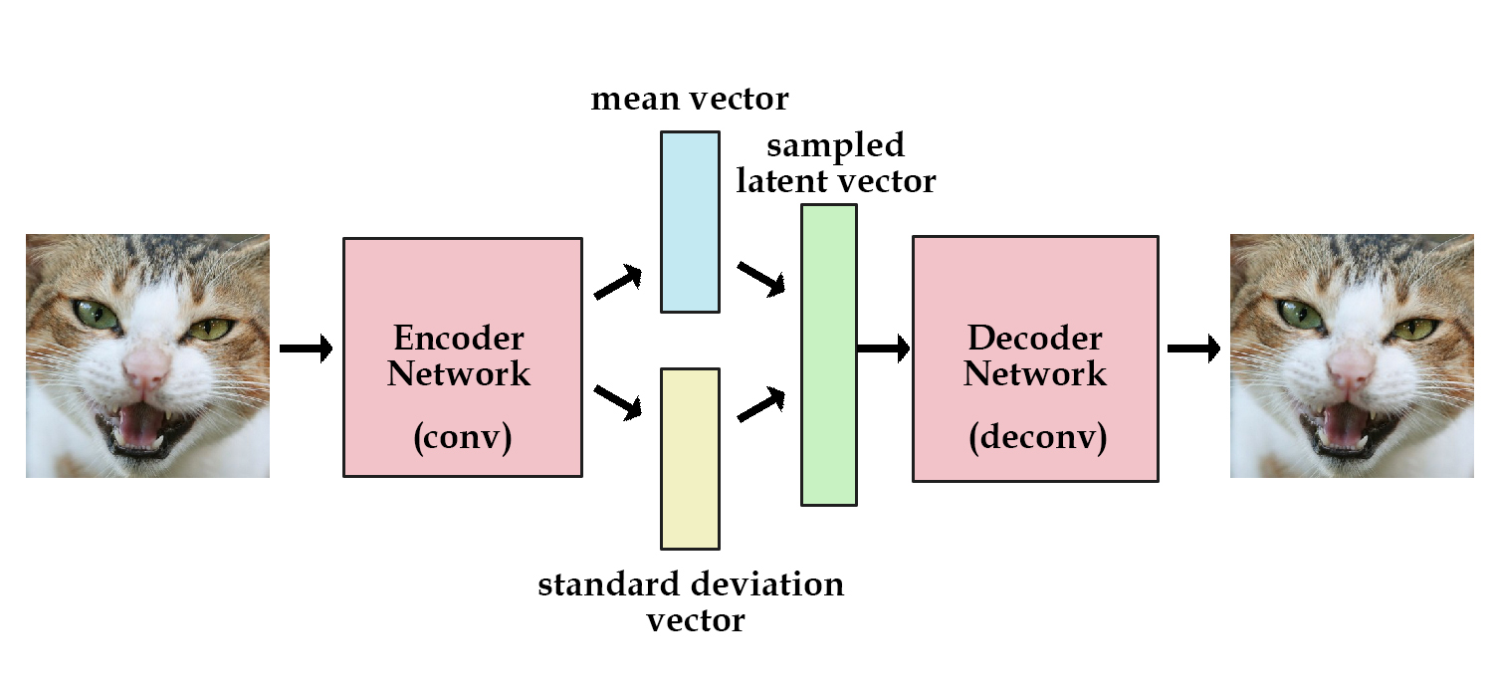
What is Variational AutoEncoder?

Slide 5
Main Components
Encoder (5 Layer Neural Network)
Takes in the Image Array and independent factors(One Hot Encoded) and returns mean and standard deviation vectors
Decoder (5 Layer Neural Network)
Takes in sample latent variables and return the image
Variational Autoencoder
Setup Network: Initializes Encoder and Decoder
Remap_y: One Hot Encodes the Image labels generating an array of 114 columns with 0’s and 1’s
Reconstruct_image: Reconstructs the image from the original image array and labels
Structural Causal Model
Takes in the Variational Autoencoder, mean and standard deviation vector
Update_noise_svi: Takes in the exogenous variables to update noise

Slide 6
Process
First of all, we split the dataset into training and testing data.
Train our variational autoencoder model
Visualize the accuracy by reconstructing a random image
Initialize structural causal model(SCM)
Visualize if our SCM model can reconstruct an image
Perform Conditioning on the SCM model for any of the independent variables
Perform Intervention to reconstruct an image by fixing one of the independent variables
Perform Counter Factual to answer questions like had the shape been a heart what would the image look like?

Slide 7
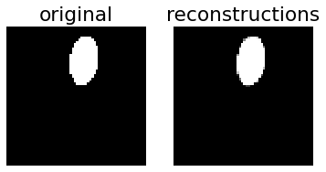
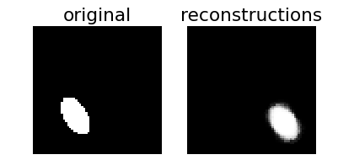
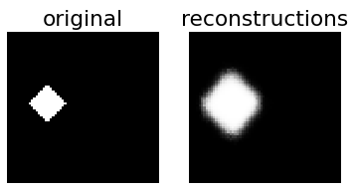
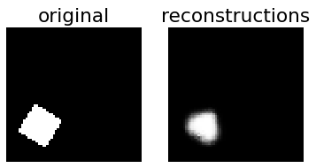
Results
Variational Autoencoder
Reconstruction
Structural Causal Model
Intervention
Conditioning
Counterfactuals
Intervention on Position X Factor
Conditioning on Scale Factor
Counterfactually creating an image with Shape as Heart

Slide 8
Optimization
The code is made compatible for GPU for faster processing.
Used cuda to enable gpu processing
The learned weights are saved to avoid training frequently to enhance development efficiency.
The model with GPU processing takes 15 mins to train, imagine how much it would take without it.

Slide 9
Applications
Generating fake human faces
Deepfakes
They are synthetic media in which a person in an existing image or video is replaced with someone else's likeness.
Producing purely synthetic music
MusicVAE
Creating a palette for musical scores with machine learning.

Slide 10
Citations and references
Robert Ness CausalML Github Repository: https://github.com/robertness/causalML
https://github.com/deepmind/dsprites-dataset
http://docs.pyro.ai/en/stable/contrib.cevae.html

